Slide 1
Data clustering (K-means)
Patuan P. Tampubolon

Slide 2
Agenda
Apa itu clustering?
Clustering use case
Pengenalan algoritma K-Means (Intuition)
Matriks evaluasi: Elbow Methdod dan Silhouette Coefficient (Intuition)
Hands-on

Slide 3
Apa itu clustering?
Goal
to discover the natural grouping(s) of a set of patterns, points, or objects.
Type
Unsupervised learning
Ideal Cluster
Compact
Isolated

Slide 4
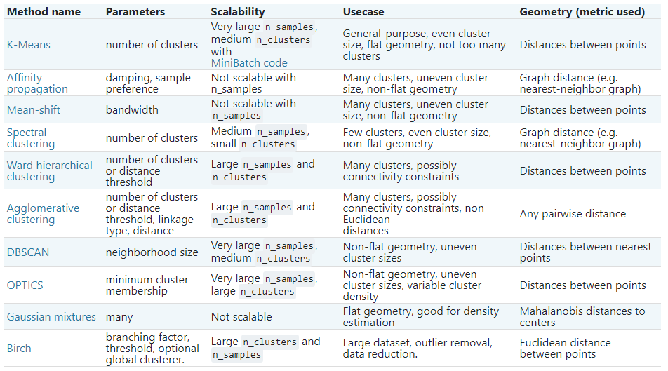
Clustering Algorithms

Slide 5
Clustering use case
Behavioral segmentation:
Segment by purchase history
Segment by activities on application, website, or platform
Define personas based on interests
Create profiles based on activity monitoring
Inventory categorization:
Group inventory by sales activity
Group inventory by manufacturing metrics

Slide 6
Clustering use case
Sorting sensor measurements:
Detect activity types in motion sensors
Group images
Separate audio
Identify groups in health monitoring
Detecting bots or anomalies:
Separate valid activity groups from bots
Group valid activity to clean up outlier detection

Slide 7
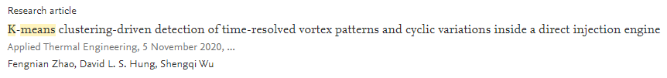




Clustering use case (2019-2020)

Slide 8
Pengenalan algoritma K-Means (Intuition)
A type of unsupervised learning
Objectives: to find K groups in the data.
clustered based on feature similarity
(e.g. distance).

Slide 9

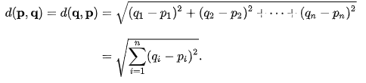

Algorithm
Inputs: Κ (number of clusters), the data set, distance metric (Euclidean Distance).
Outputs : centroids and each data point is assigned to a single cluster
Initial estimates for the Κ centroids, (randomly generated or randomly selected from the data set)
Iterates over:
Data assignment step:
Each centroid defines one of the clusters.
Each data point is assigned to its nearest centroid, based on the squared Euclidean distance.
Centroid update step:
The centroids are recomputed
By taking the mean of all data points assigned to that centroid's cluster
Repeat until convergence:
no data points change clusters
the sum of the distances is minimized
some maximum number of iterations is reached

Slide 10






 | A | B
S1 | 1.0 | 1.0
S2 | 1.5 | 2.0
S3 | 3.0 | 4.0
S4 | 5.0 | 7.0
S5 | 3.5 | 5.0
S6 | 4.5 | 5.0
S7 | 3.5 | 4.5
K = 2
Calculate distances for S2:
Randomly selected data for centroid:
$$d\left(c1,S2\right)= \sqrt{{(1.0−1.5)}^{2}+{(1.0−2.0)}^{2}}=1.12$$
 | Individual | Centroid
Cluster 1 | S1 | (1.0, 1.0)
Cluster 2 | S4 | (5.0, 7.0)
$$d\left(c2,S2\right)= \sqrt{{(5.0−1.5)}^{2}+{(7.0−2.0)}^{2}}=6.10$$
Update the centroid:
$$\frac{1}{2}∗\left(1.0+1.5\right)=1.25≈1.2$$
$$\frac{1}{2}∗\left(1.0+2\right)=1.5$$
Calculate distances for S3:
 | Cluster 1 |  | Cluster 2
Step | Individual | Centroid | individual | Centroid
1 | S1 | (1.0, 1.0) | S4 | (5.0, 7.0)
2 | S1, S2 | (1.2, 1.5) | S4 | (5.0, 7.0)
3
4
5
6
$d\left(c1,S3\right)≈3.05$
 | Cluster 1 |  | Cluster 2
Step | Individual | Centroid | individual | Centroid
1 | S1 | (1.0, 1.0) | S4 | (5.0, 7.0)
2 | S1, S2 | (1.2, 1.5) | S4 | (5.0, 7.0)
3 | S1,S2,S3 | (1.8, 2.3) | S4 | (5.0, 7.0)
4
5
6
 | Cluster 1 |  | Cluster 2
Step | Individual | Centroid | individual | Centroid
1 | S1 | (1.0, 1.0) | S4 | (5.0, 7.0)
2 | S1, S2 | (1.2, 1.5) | S4 | (5.0, 7.0)
3 | S1,S2,S3 | (1.8, 2.3) | S4 | (5.0, 7.0)
4 | S1,S2,S3 | (1.8, 2.3) | S4, S5 | (4.2, 6.0)
5 | S1,S2,S3 | (1.8, 2.3) | S4, S5, S6 | (4.3, 5.7)
6 | S1,S2,S3 | (1.8, 2.3) | S4,S5,S6,S7 | (4.1, 5.4)
$d\left(c2,S3\right)≈3.61$
Update the centroid:
$\frac{1}{3}∗\left(1.0+1.5+3.0\right)=1.8\overline{33}≈1.$8
$$\frac{1}{3}∗\left(1.0+2.0+4.0\right)=2.\overline{33}≈2.3$$

Slide 11
 | A | B
S1 | 1.0 | 1.0
S2 | 1.5 | 2.0
S3 | 3.0 | 4.0
S4 | 5.0 | 7.0
S5 | 3.5 | 5.0
S6 | 4.5 | 5.0
S7 | 3.5 | 4.5
K = 2
Inisialisasi centroid:
 | Individual | Centroid
Cluster 1 | S1,S2,S3 | (1.8, 2.3)
Cluster 2 | S4,S5,S6,S7 | (4.1, 5.4)
 | Individual | Centroid
Cluster 1 | S1 | (1.0, 1.0)
Cluster 2 | S4 | (5.0, 7.0)
 | d(c1,si) | d(c2,si)
S1 | 1.5 | 5.4
S2 | 0.4 | 4.3
S3 | 2.1 | 1.8
S4 | 5.7 | 1.8
S5 | 3.2 | 0.7
S6 | 3.8 | 0.6
S7 | 2.8 | 1.1
 | Cluster 1 |  | Cluster 2
Step | Individual | Centroid | individual | Centroid
1 | S1 | (1.0, 1.0) | S4 | (5.0, 7.0)
2 | S1, S2 | (1.2, 1.5) | S4 | (5.0, 7.0)
3 | S1,S2,S3 | (1.8, 2.3) | S4 | (5.0, 7.0)
4 | S1,S2,S3 | (1.8, 2.3) | S4, S5 | (4.2, 6.0)
5 | S1,S2,S3 | (1.8, 2.3) | S4, S5, S6 | (4.3, 5.7)
6 | S1,S2,S3 | (1.8, 2.3) | S4,S5,S6,S7 | (4.1, 5.4)
 | Individual | Centroid
Cluster 1 | S1,S2 | (1.8, 2.3)
Cluster 2 | S3, S4,S5,S6,S7 | (4.1, 5.4)

Slide 13
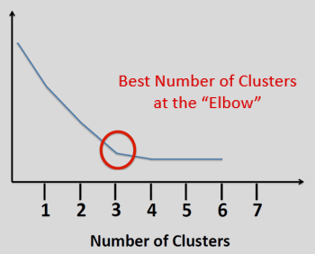
Matriks evaluasi: Elbow Methdod

Slide 14
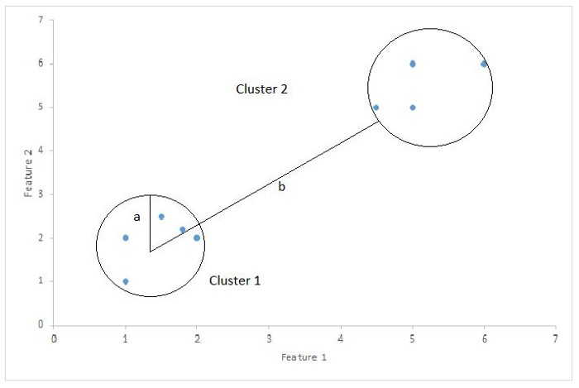

Matriks evaluasi: Silhouette Coefficient
Silhouette Coefficient or silhouette score is a metric used to calculate the goodness of a clustering technique.
$$Silhouette Score= (b−a)/max⁡(a, b)$$
a= the average distance between each point within a cluster.
b= the average distance between all clusters.
1: clusters are clearly distinguished from each other .
0: the distance between clusters is not significant.
-1: clusters are assigned in the wrong way.

Slide 15
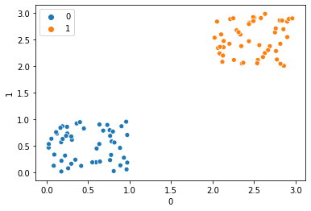
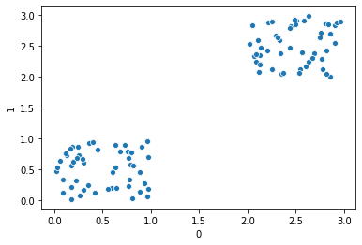
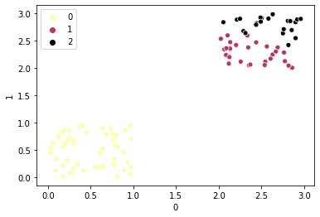
K = 2
K = 3

Slide 16
Hands-on

Slide 17
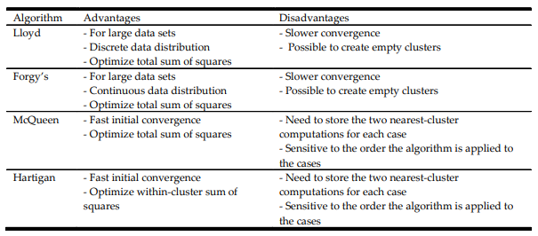
Further reading
https://www.sciencedirect.com/science/article/pii/0377042787901257?via%3Dihub
http://proceedings.mlr.press/v9/telgarsky10a/telgarsky10a.pdf
http://www.tqmp.org/RegularArticles/vol09-1/p015/p015.pdf

Slide 18
Self exercises 1
 | A | B
S1 | 2.0 | 1.0
S2 | 1.0 | 2.0
S3 | 7.0 | 4.5
S4 | 2.0 | 5.0
S5 | 3.5 | 5.5
S6 | 4.5 | 2.0
S7 | 3.5 | 4.0
S8 | 2.5 | 2.5
S9 | 4.5 | 1.0
Find the cluster with manual calculation of K-means algorithm K = 3 and 2 iterations.

Slide 19
Self exercises 2
Use the sepal length, sepal width, petal length, and petal width from iris dataset to find three clusters.
Compare your findings from a) with the target from the dataset.
Find the best K from the dataset using Elbow Method.
Find the best K from the dataset using the Silhouette Coefficient.
Use scikitlearn to answer a), c) and d)

Slide 20
Referensi:
https://blogs.oracle.com/datascience/introduction-to-k-means-clustering
http://mnemstudio.org/clustering-k-means-example-1.htm
https://en.wikipedia.org/wiki/Euclidean_distance#:~:text=In%20mathematics%2C%20the%20Euclidean%20distance,metric%20as%20the%20Pythagorean%20metric.
https://towardsdatascience.com/silhouette-coefficient-validating-clustering-techniques-e976bb81d10c
https://scikit-learn.org/stable/modules/clustering.html#k-means
https://www.sciencedirect.com/science/article/abs/pii/S0167865509002323

